Slide 1

midterm progress update:
counterintuitive properties of advx
disco group, ethz – prof. wattenhofer

Slide 2
a traditional introduction

Slide 3
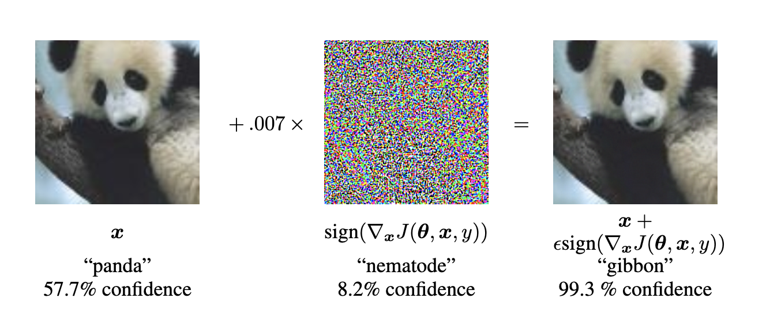
adversarial examples (in computer vision):
𝑋 input image
𝑃 perturbation
𝑋 + 𝑃 · ε perturbed input no semantic loss, recognizable to humans
𝑓: 𝑋 → 𝑦 classifier trying to fit human perception
𝒽: 𝑋 → 𝑦 human judgement implicit
𝑓(𝑋 + 𝑃) = 𝑡 misclassification target based on perturbation
goodfellow et al. (ICLR 2015)
https://arxiv.org/pdf/1412.6572

Slide 4
adversarial examples (in computer vision):
𝑋 input image
𝑃 perturbation
𝑋 + 𝑃 · ε perturbed input no semantic loss, recognizable to humans
𝑓: 𝑋 → 𝑦 classifier trying to fit human perception
𝒽: 𝑋 → 𝑦 human judgement implicit
𝑓(𝑋 + 𝑃) = 𝑡 misclassification target based on perturbation
can you tell the difference?
if not, then that’s a bad sign.
goodfellow et al. (ICLR 2015)
https://arxiv.org/pdf/1412.6572

Slide 5
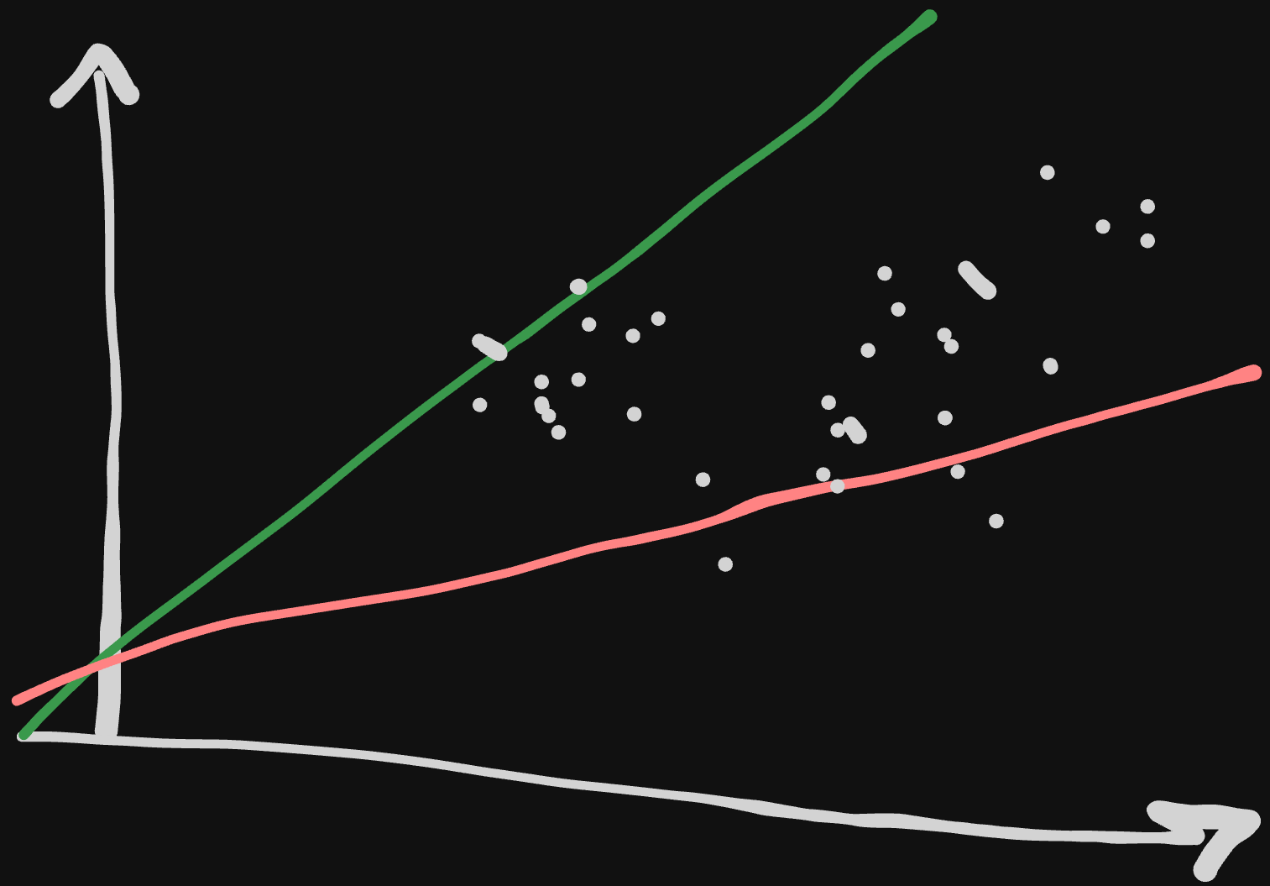
adversarial examples (in computer vision):
𝑋 input image
𝑃 perturbation
𝑋 + 𝑃 · ε perturbed input no semantic loss, recognizable to humans
𝑓: 𝑋 → 𝑦 classifier trying to fit human perception
𝒽: 𝑋 → 𝑦 human judgement implicit
𝑓(𝑋 + 𝑃) = 𝑡 misclassification target based on perturbation
human-machine
vision gap

Slide 6
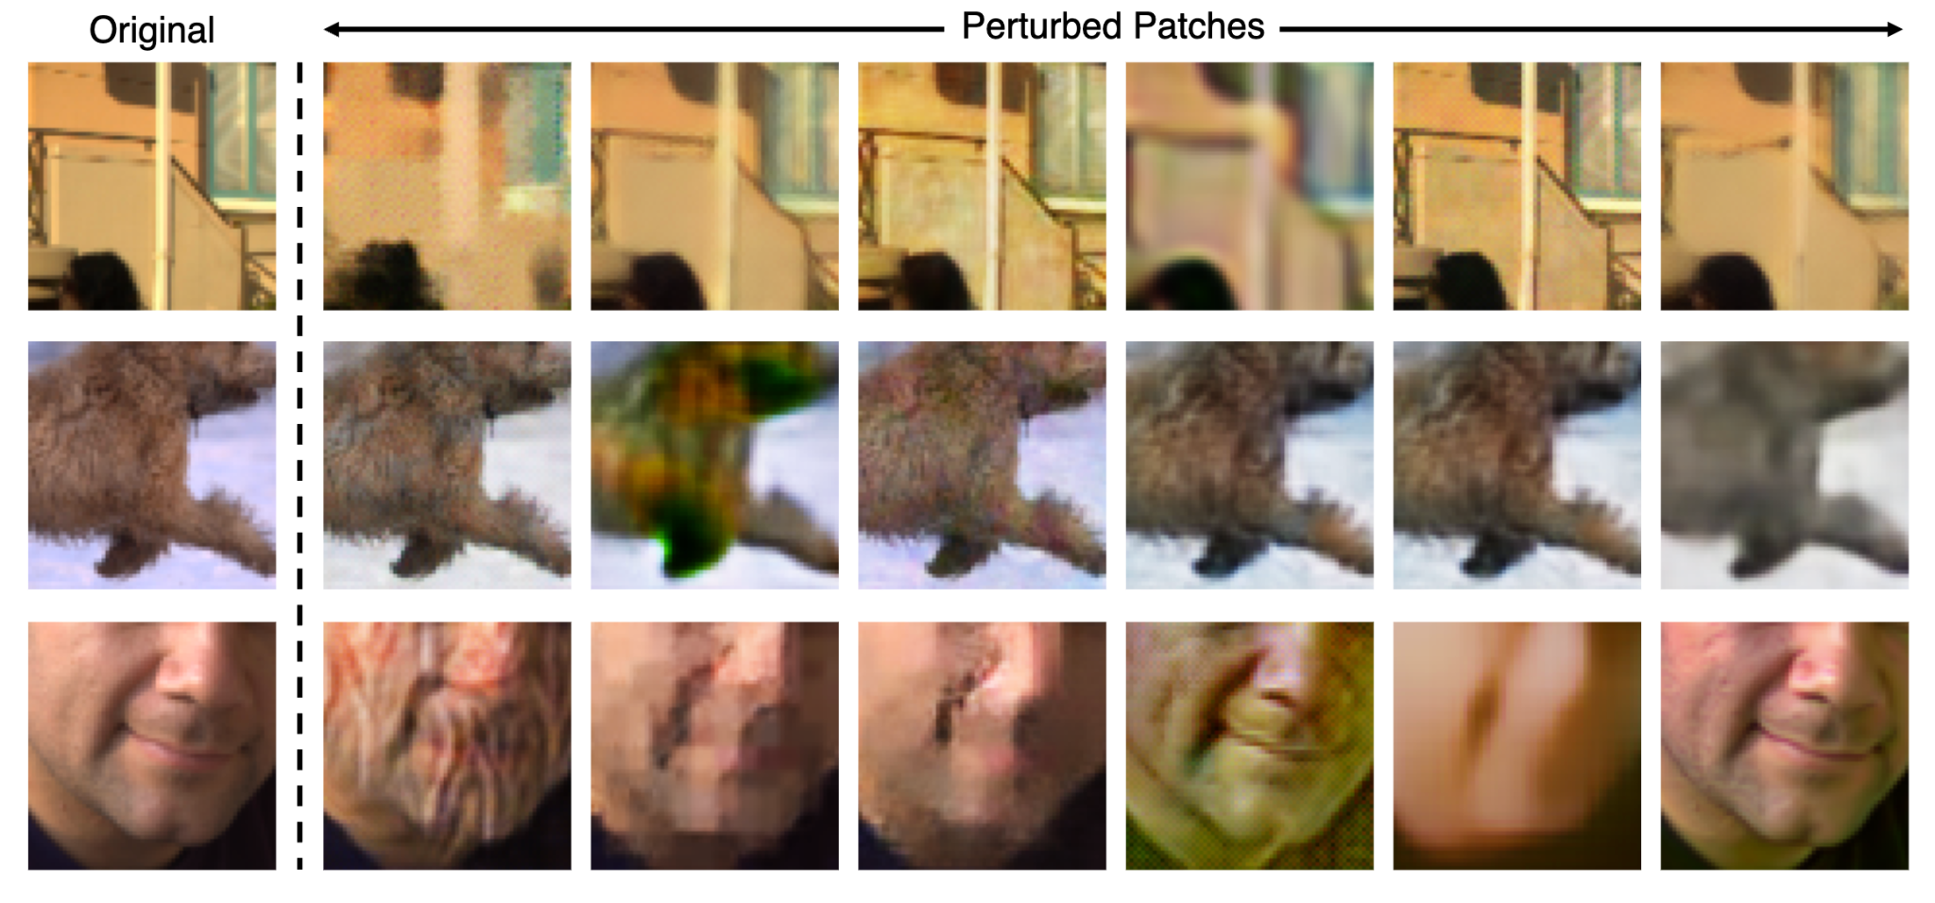
adversarial examples (in computer vision):
𝑋 input image
𝑃 perturbation
𝑋 + 𝑃 · ε perturbed input no semantic loss, recognizable to humans
𝑓: 𝑋 → 𝑦 classifier trying to fit human perception
𝒽: 𝑋 → 𝑦 human judgement implicit
𝑓(𝑋 + 𝑃) = 𝑡 misclassification target based on perturbation
semantic similarity metrics like (LPIPS)

Slide 7
unsolved mysteries

Slide 8
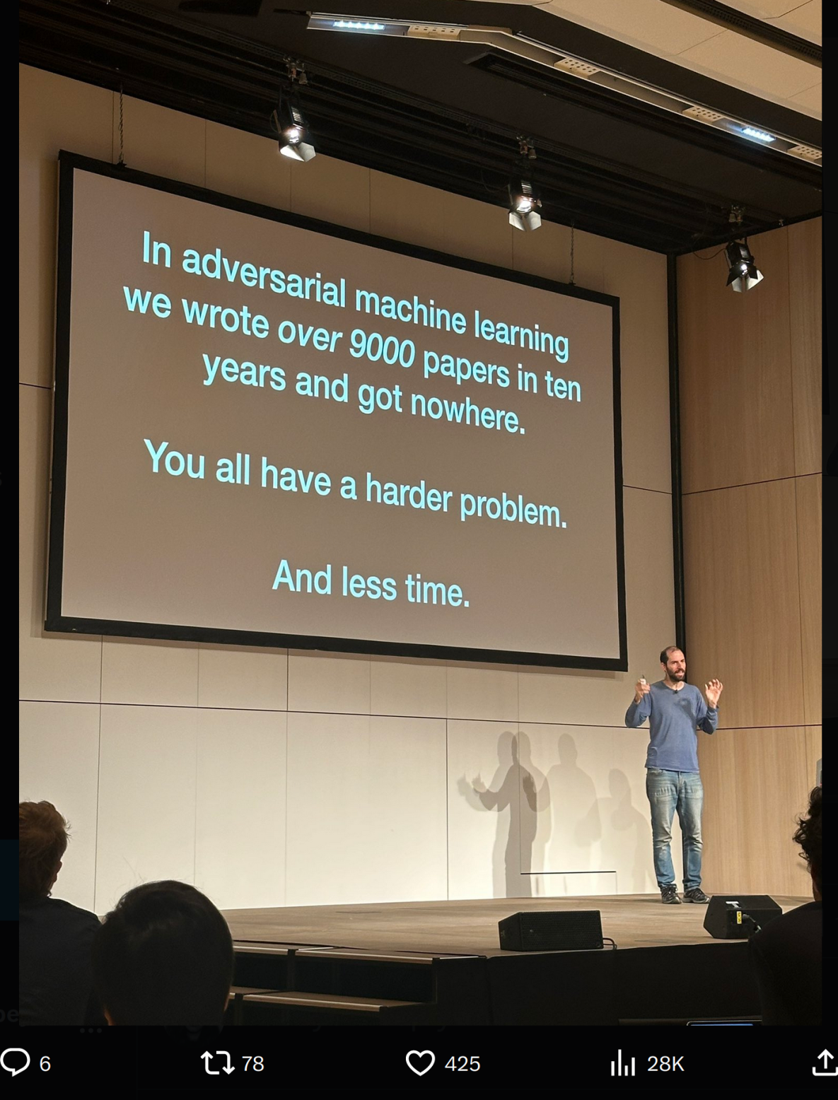
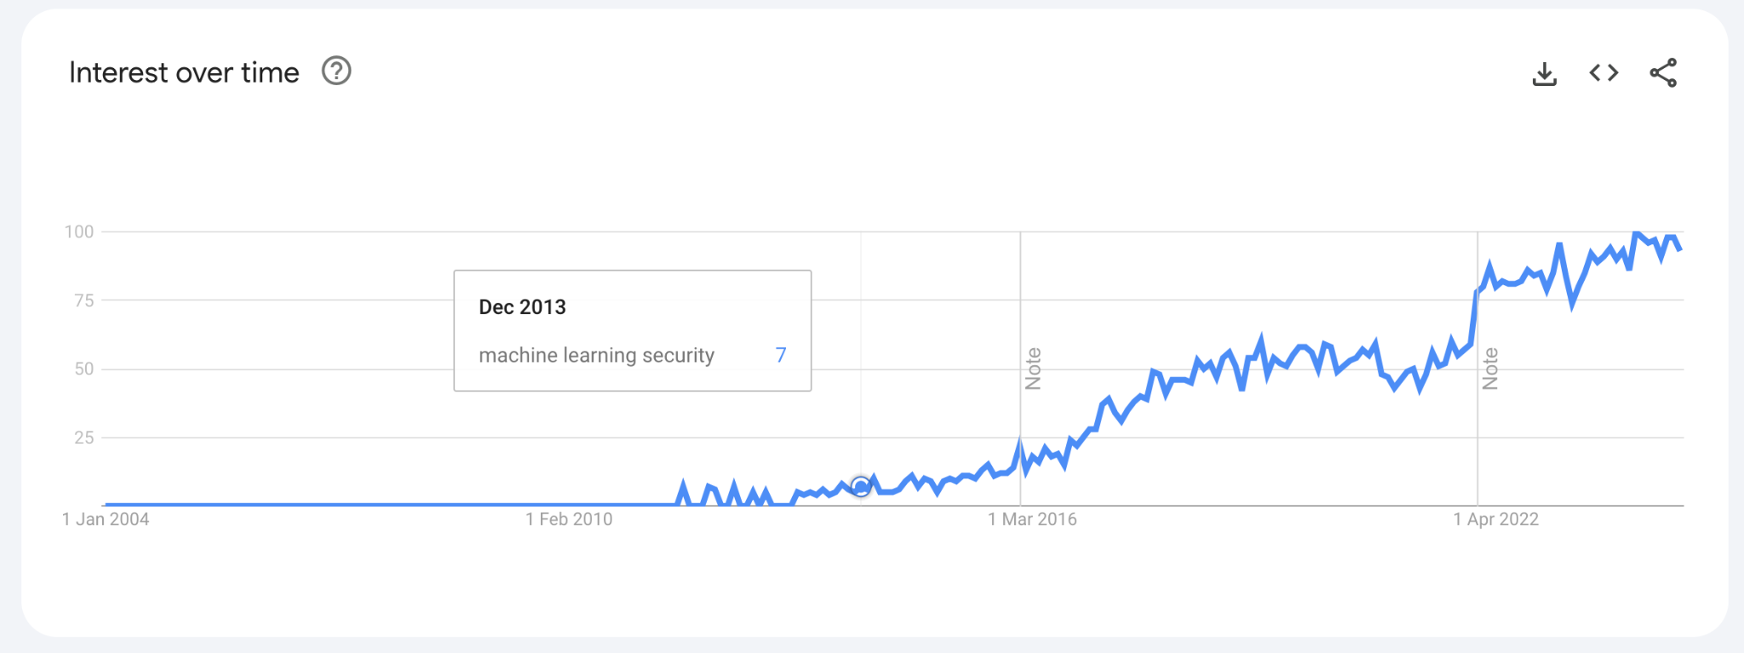
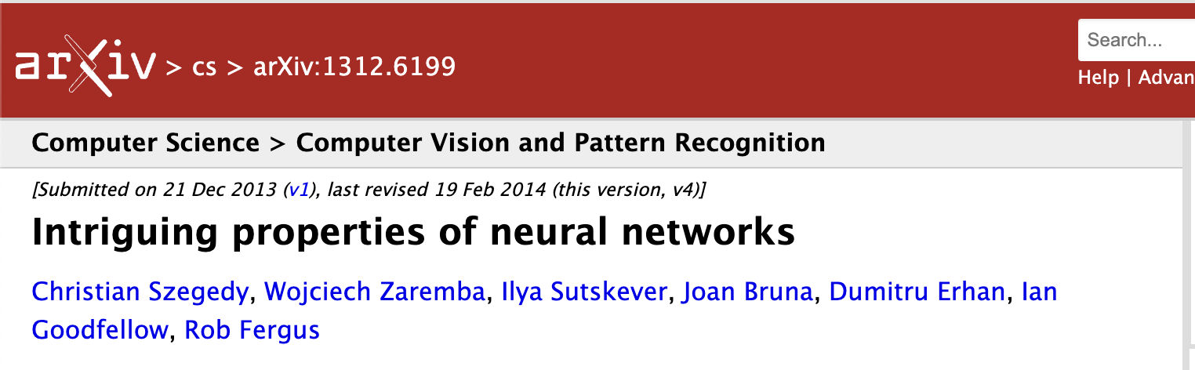

Slide 9
adversarial examples: unsolved mysteries
- what are they?
- why are they so close to the image?
- why don’t they resemble the target class?
- why do adversarial robustness and accuracy trade-off?
- ...

Slide 10
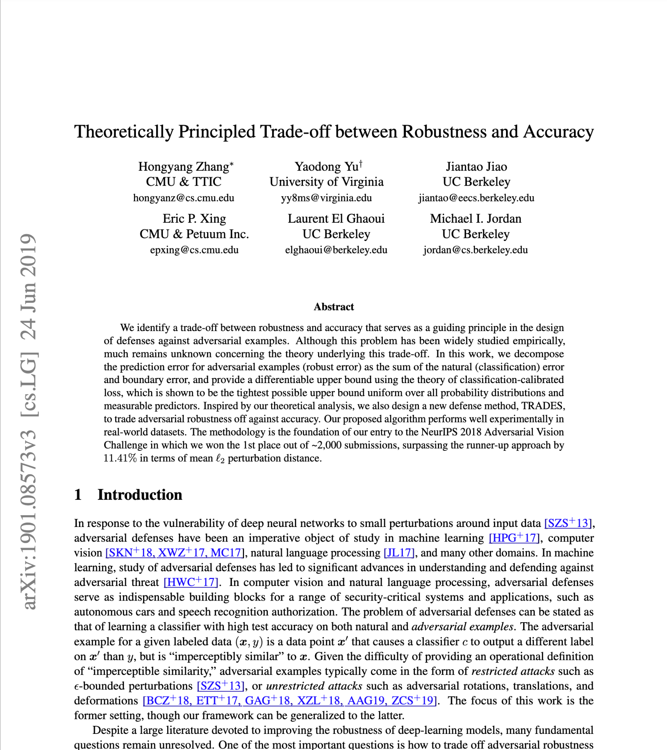
adversarial examples: unsolved mysteries
- what are they?
- why are they so close to the image?
- why don’t they resemble the target class?
- why do adversarial robustness and accuracy trade-off?
- ...
formal definition:
informal definition:
not being fooled by the perturbations

Slide 11

adversarial examples: unsolved mysteries
- what are they?
- why are they so close to the image?
- why don’t they resemble the target class?
- why do adversarial robustness and accuracy trade-off?
adi shamir: “Any attempt to robustify a network by limiting all its directional
derivatives will make it harder to train and thus less accurate.”
shamir et al.
https://arxiv.org/pdf/2106.10151

Slide 12

adversarial examples: unsolved mysteries
- what are they?
- why are they so close to the image?
- why don’t they resemble the target class?
- why do adversarial robustness and accuracy trade-off?
adi shamir: “Any attempt to robustify a network by limiting all its directional
derivatives will make it harder to train and thus less accurate.”
madry’s lab:
a) useless features not picked up by feature extractor
b) robust features comprehensible to humans, stable under perturbations
c) non-robust features incomprehensible to humans
very predictive but also very brittle
derived from data distribution patterns
ilyas et al. https://arxiv.org/pdf/1905.02175

Slide 13
adversarial examples: unsolved mysteries
- what are they?
- why are they so close to the image?
- why don’t they resemble the target class?
- why do adversarial robustness and accuracy trade-off?
adi shamir: “Any attempt to robustify a network by limiting all its directional
derivatives will make it harder to train and thus less accurate.”
madry’s lab:
a) useless features not picked up by feature extractor
b) robust features comprehensible to humans, stable under perturbations
c) non-robust features incomprehensible to humans
very predictive but also very brittle
derived from data distribution patterns
predictive accuracy without generalizability is useless for for downstream tasks.

Slide 14
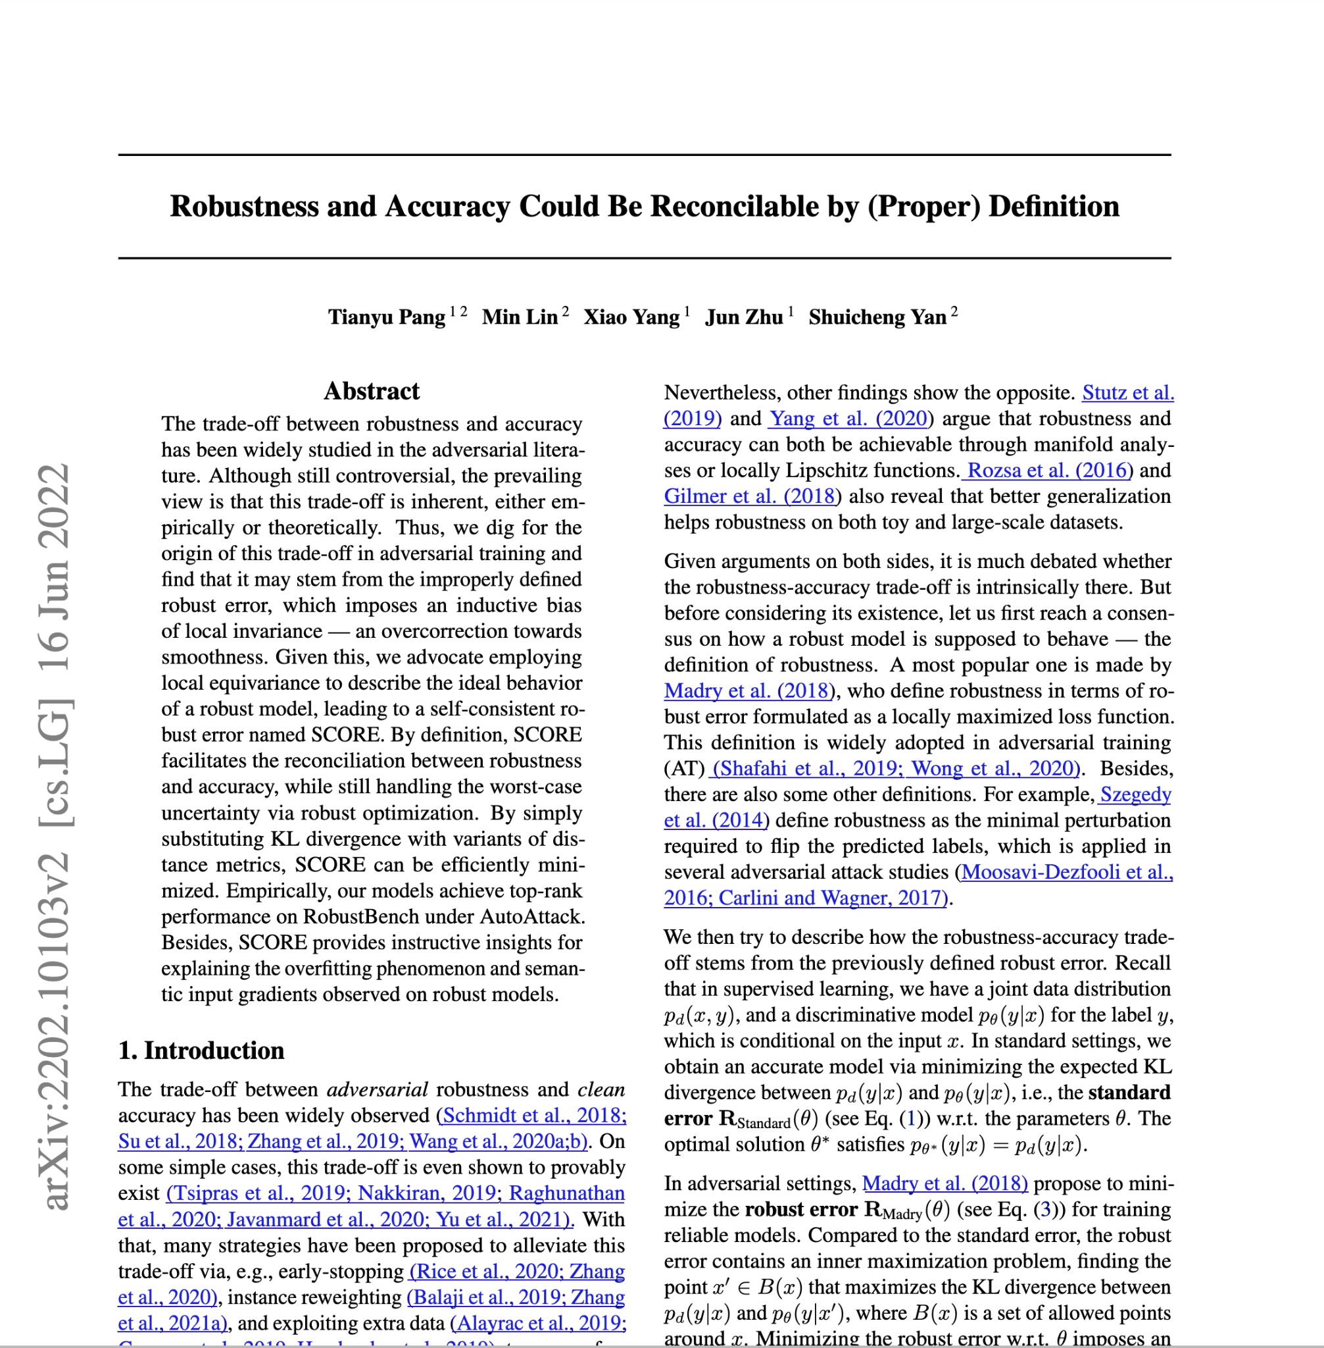
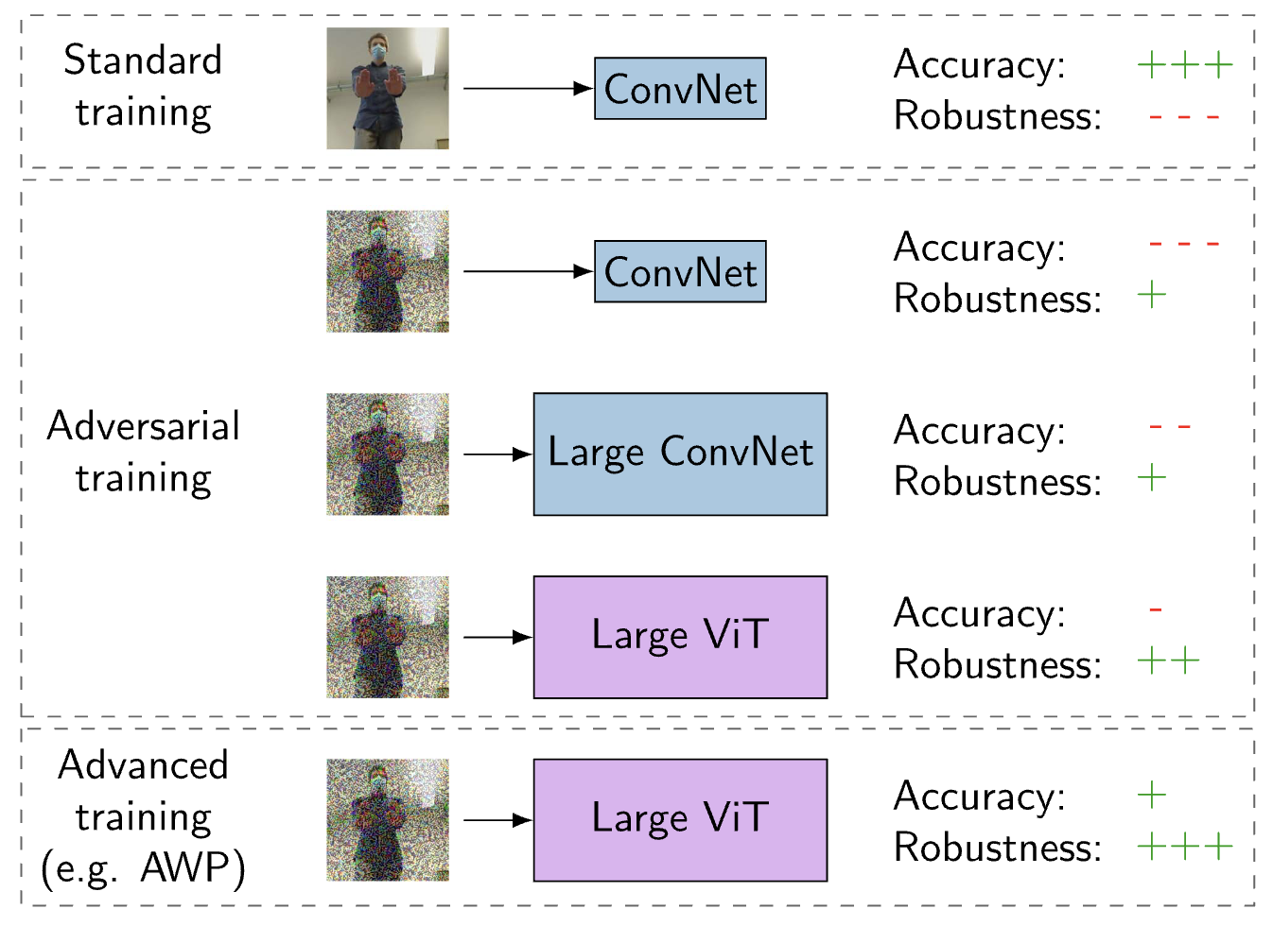
there is a solution!
Lechner, Mathias, et al. "Revisiting the adversarial robustness-accuracy tradeoff in robot learning." IEEE Robotics and Automation Letters 8.3 (2023): 1595-1602.

Slide 15
in conclusion:
adversarial examples are about generalizability, not security.
they help us:
- to augment data such that models learn the right features
- understand the learning process & human-machine vision gap

Slide 16
my progress

Slide 17
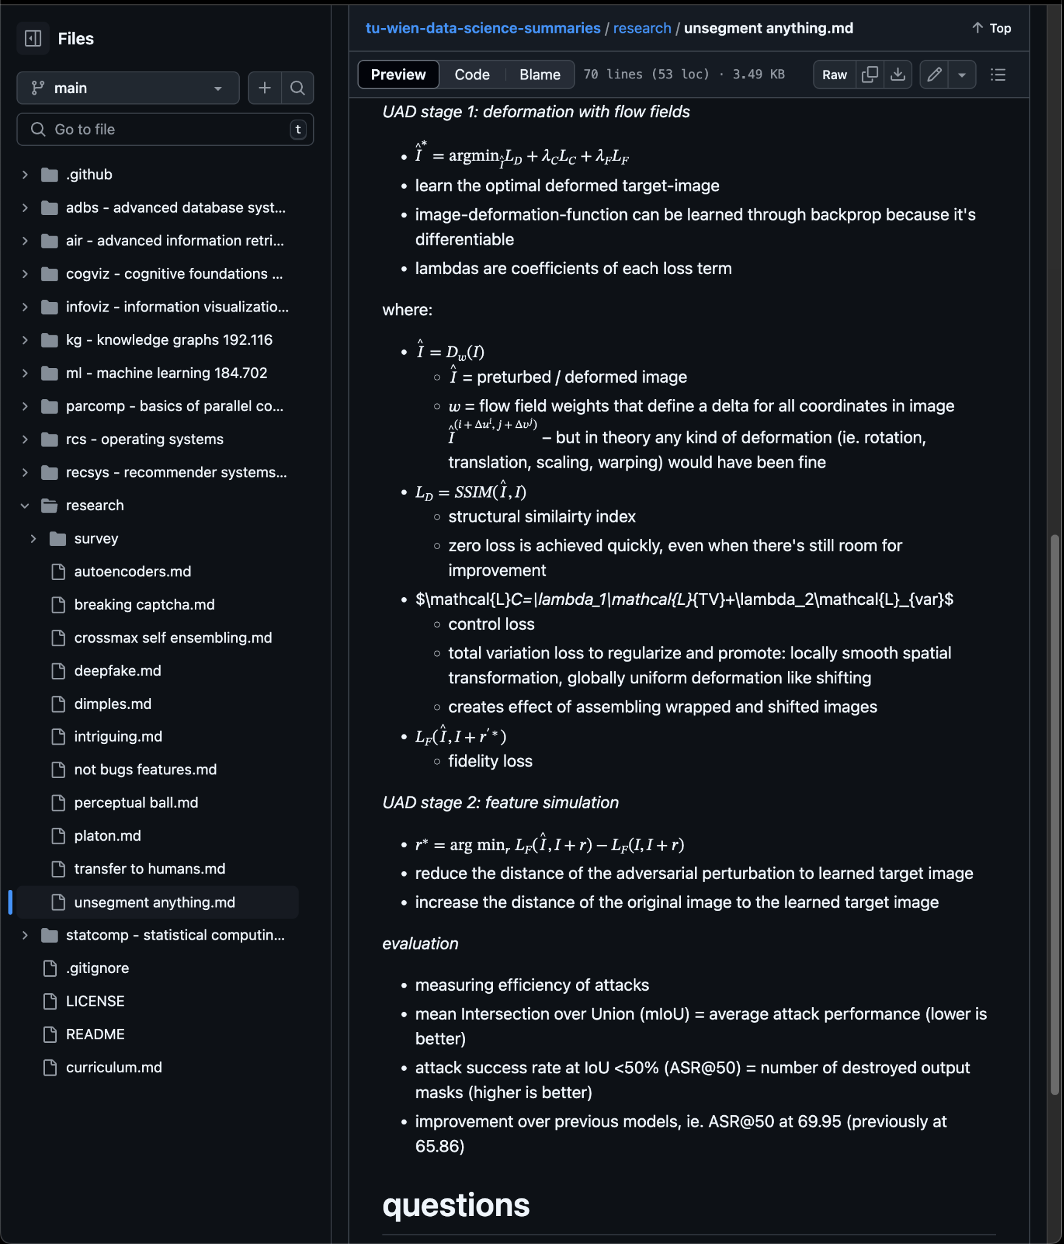
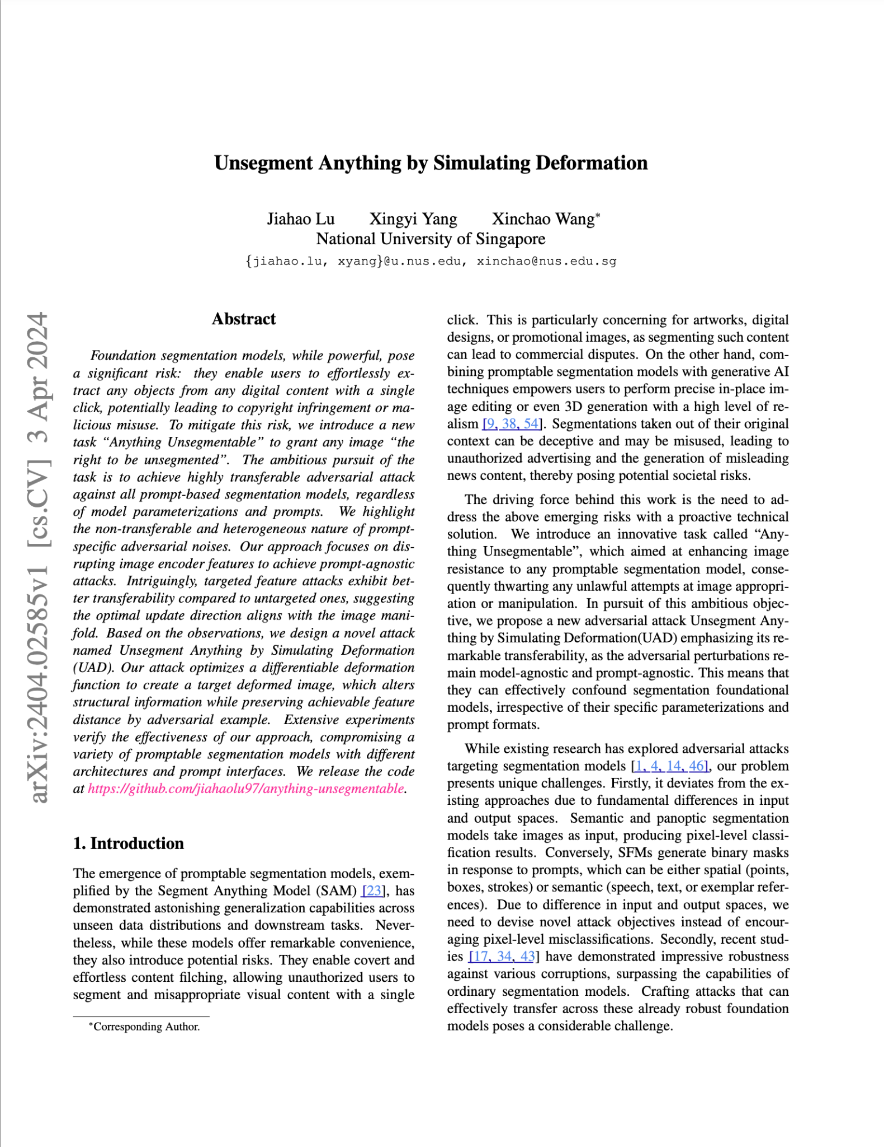
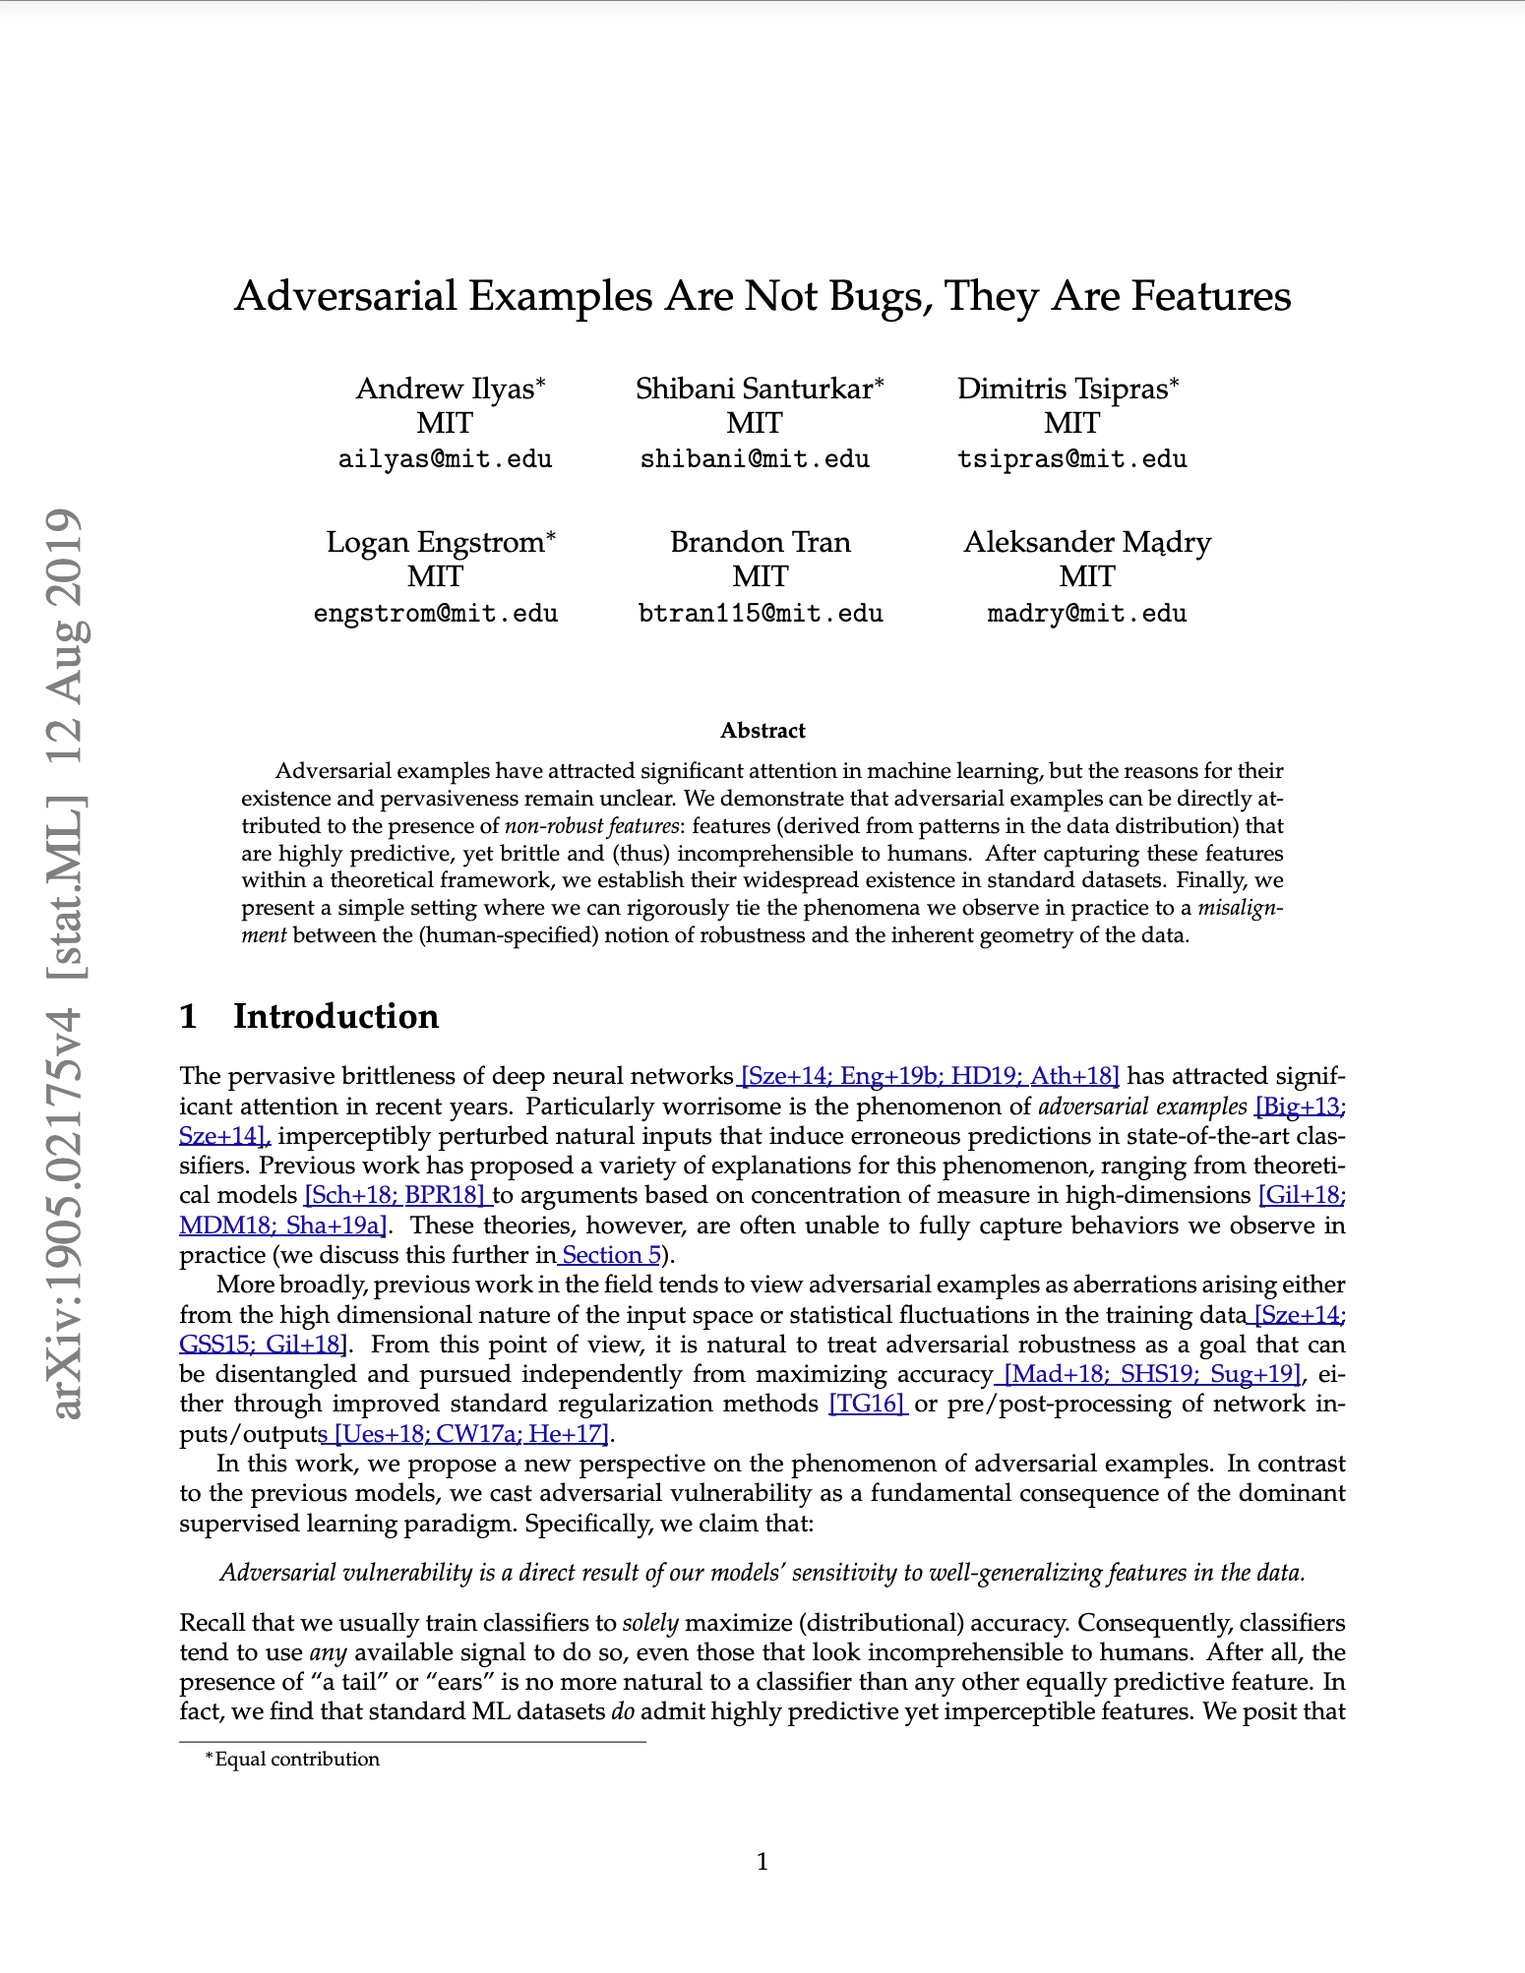
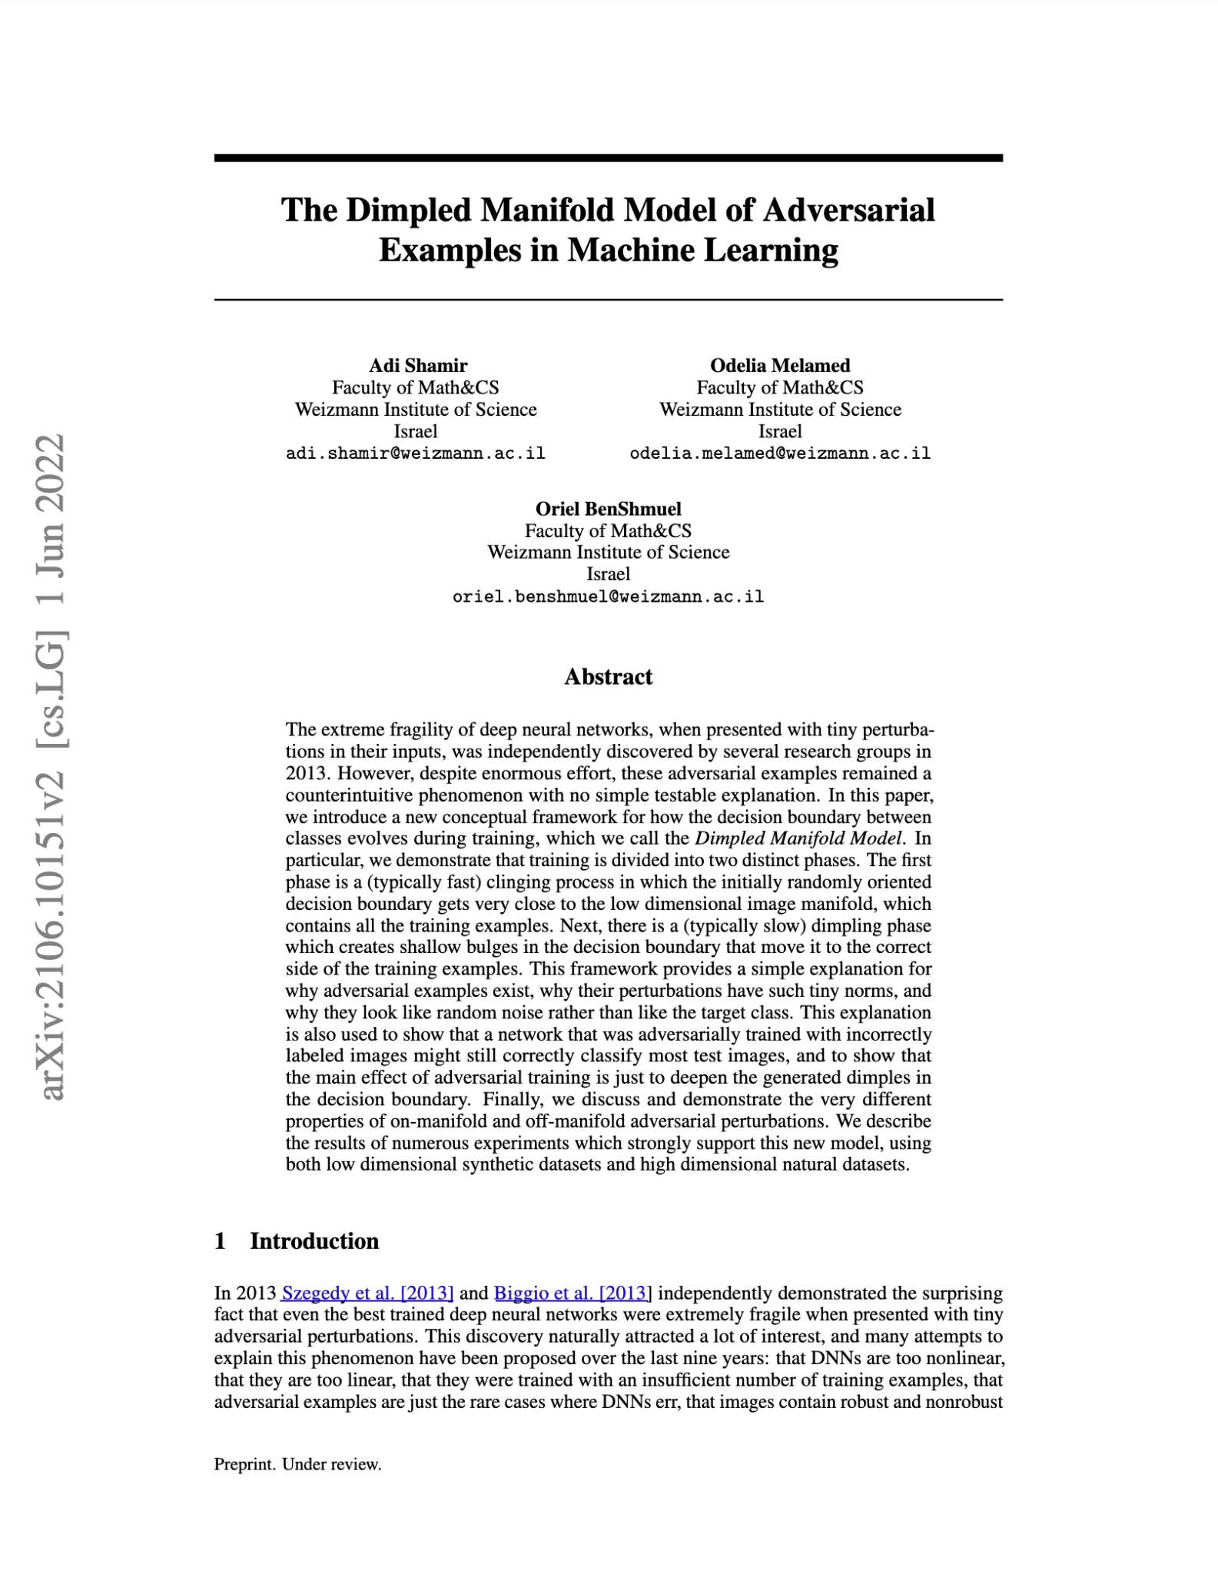
steps:
0. literature review

Slide 18
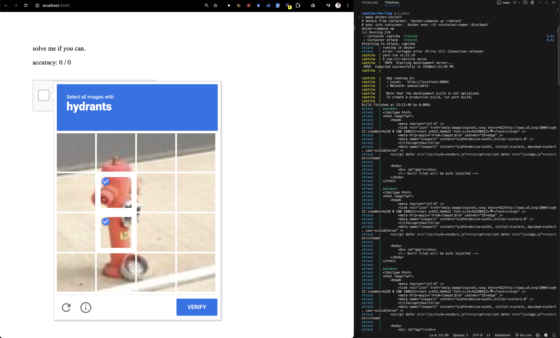
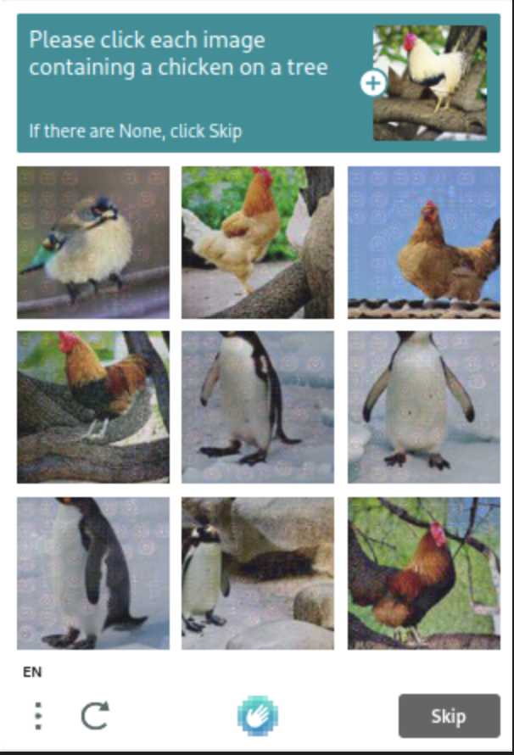
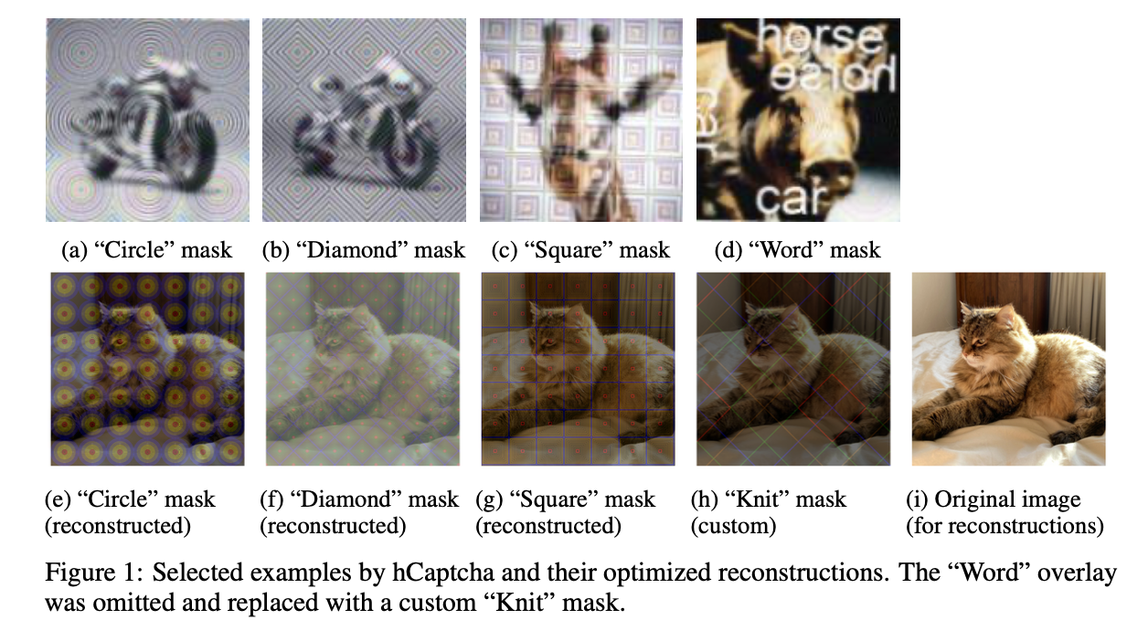
steps:
0. literature review
1. getting inspired by hCaptcha perturbations
- building an offline CAPTCHA clone
- rendering hCAPTCHA masks
blackbox, not model specific
just manipulates contours and colors

Slide 19
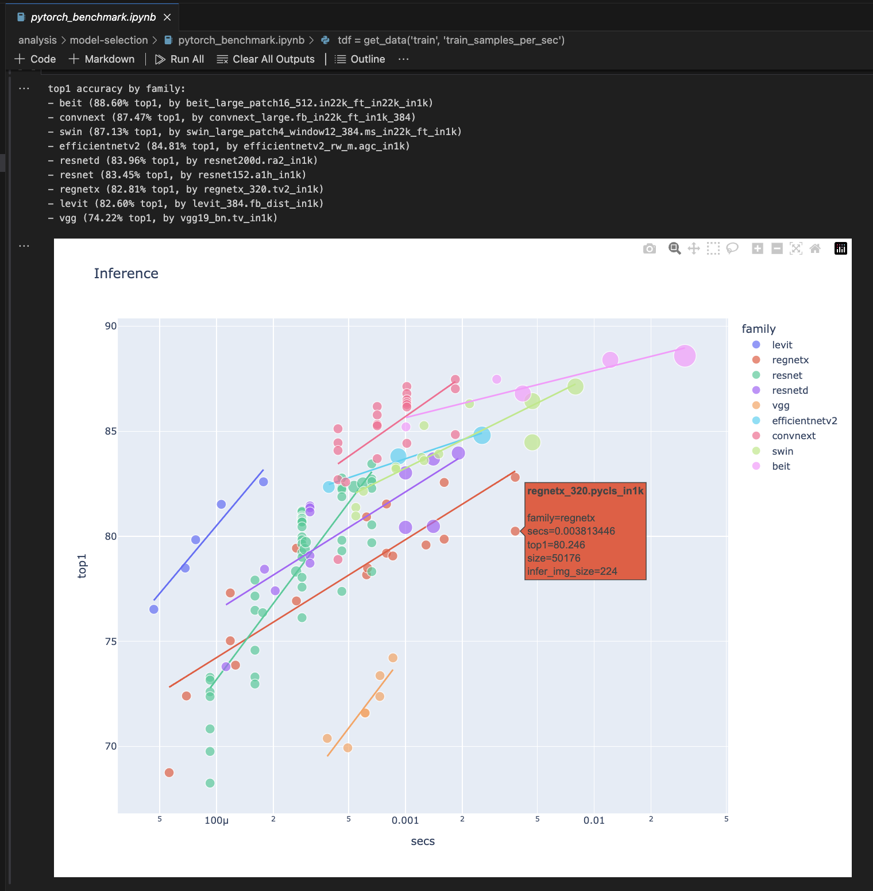
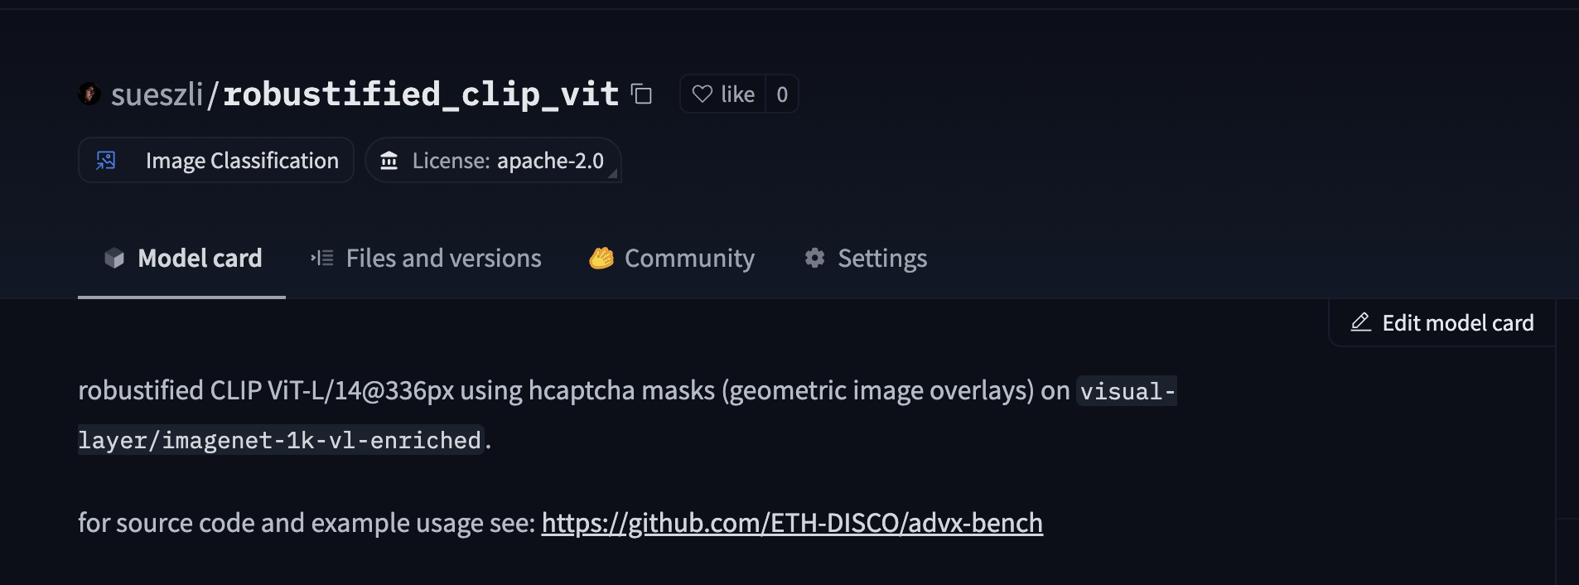
steps:
0. literature review
1. getting inspired by hCaptcha perturbations
2. selecting the best performing models
- comparing models by family
- comparing zero shot benchmark leaderboards
- ie. robustbench
- fine tuning the best performing model

Slide 20
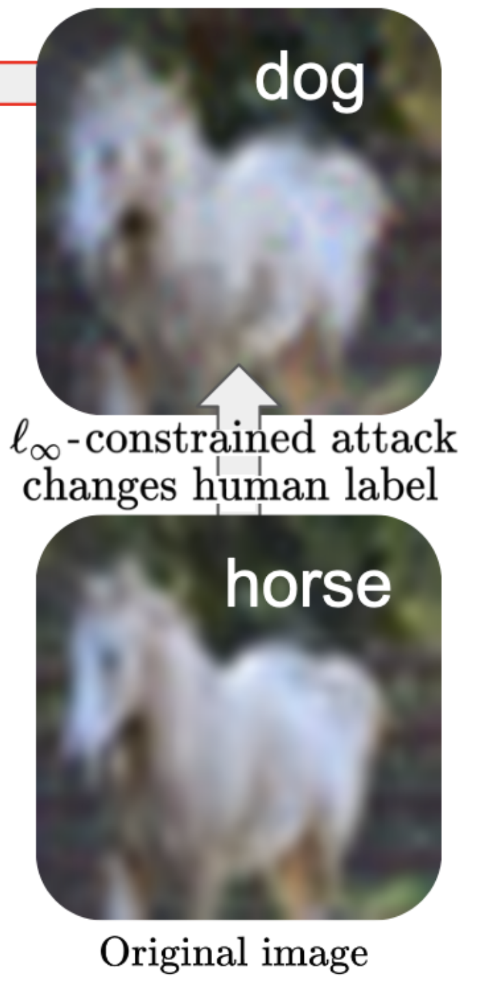
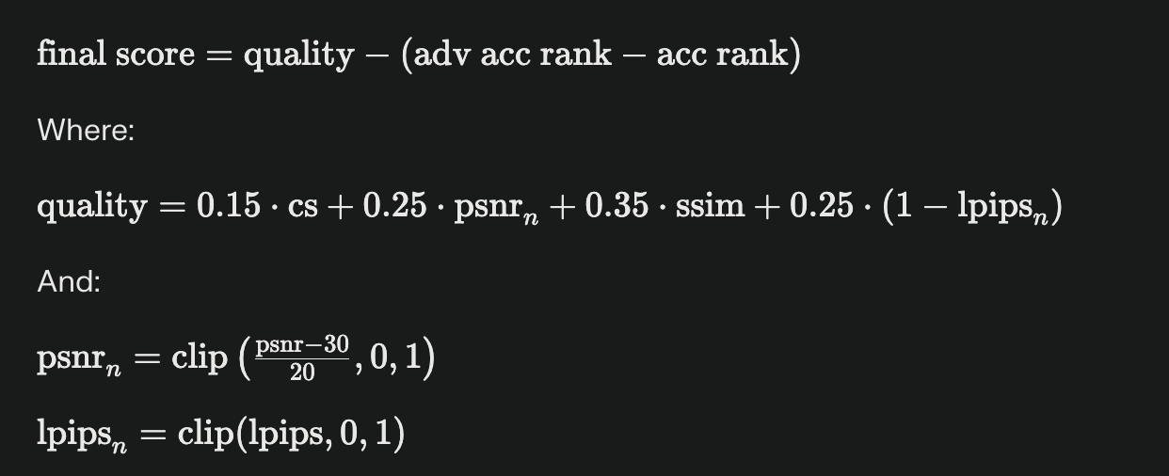
steps:
0. literature review
1. getting inspired by hCaptcha perturbations
2. selecting the best performing models
3. designing experiments
- imagenet + hcaptcha perturbations
- hyperparameter optimization (opacity, density, fgsm epsilon)
- perceptual quality metrics to avoid transfer to humans
Bartoldson, Brian R., et al. "Adversarial Robustness Limits via Scaling-Law and Human-Alignment Studies." arXiv preprint arXiv:2404.09349 (2024).

Slide 21
steps:
0. literature review
1. getting inspired by hCaptcha perturbations
2. selecting the best performing models
3. designing experiments
4. benchmarking
- 2.0 weeks of cluster debugging & writing docs (see: @ETH-DISCO/cluster-tutorial)
- 1.0 weeks of hyperparam tuning
- 0.5 weeks of experimentation

Slide 22
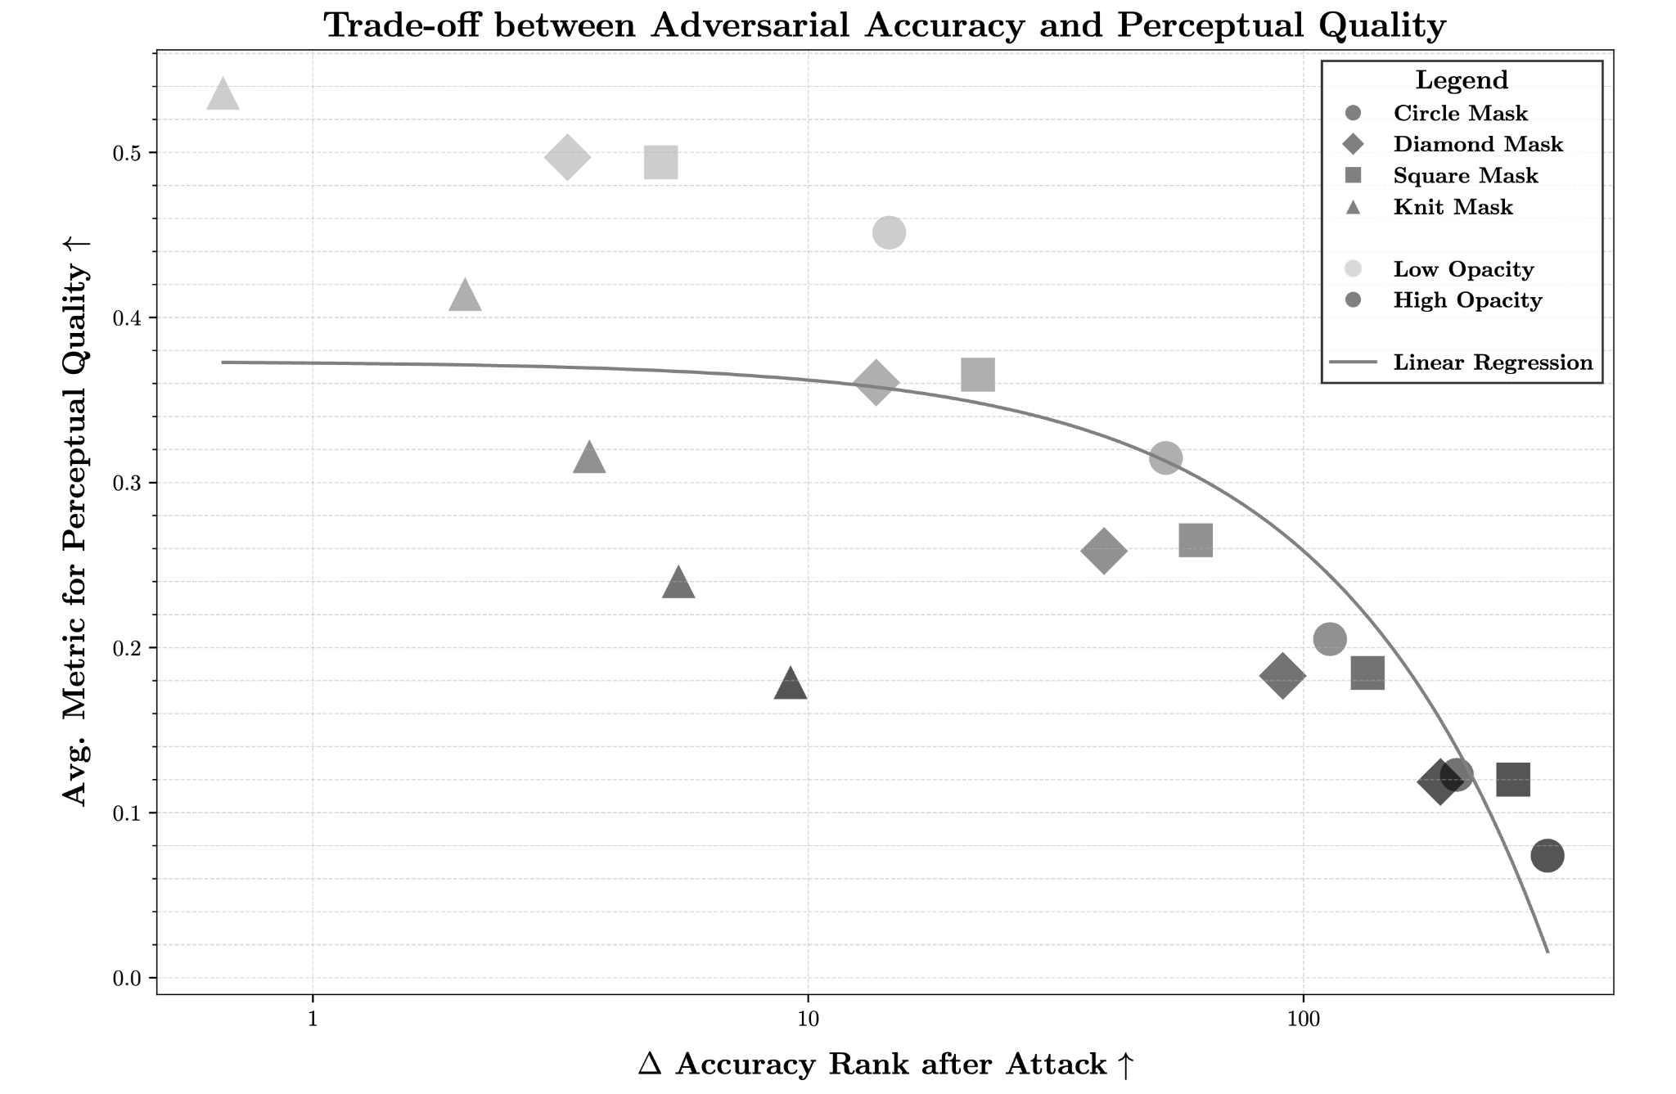
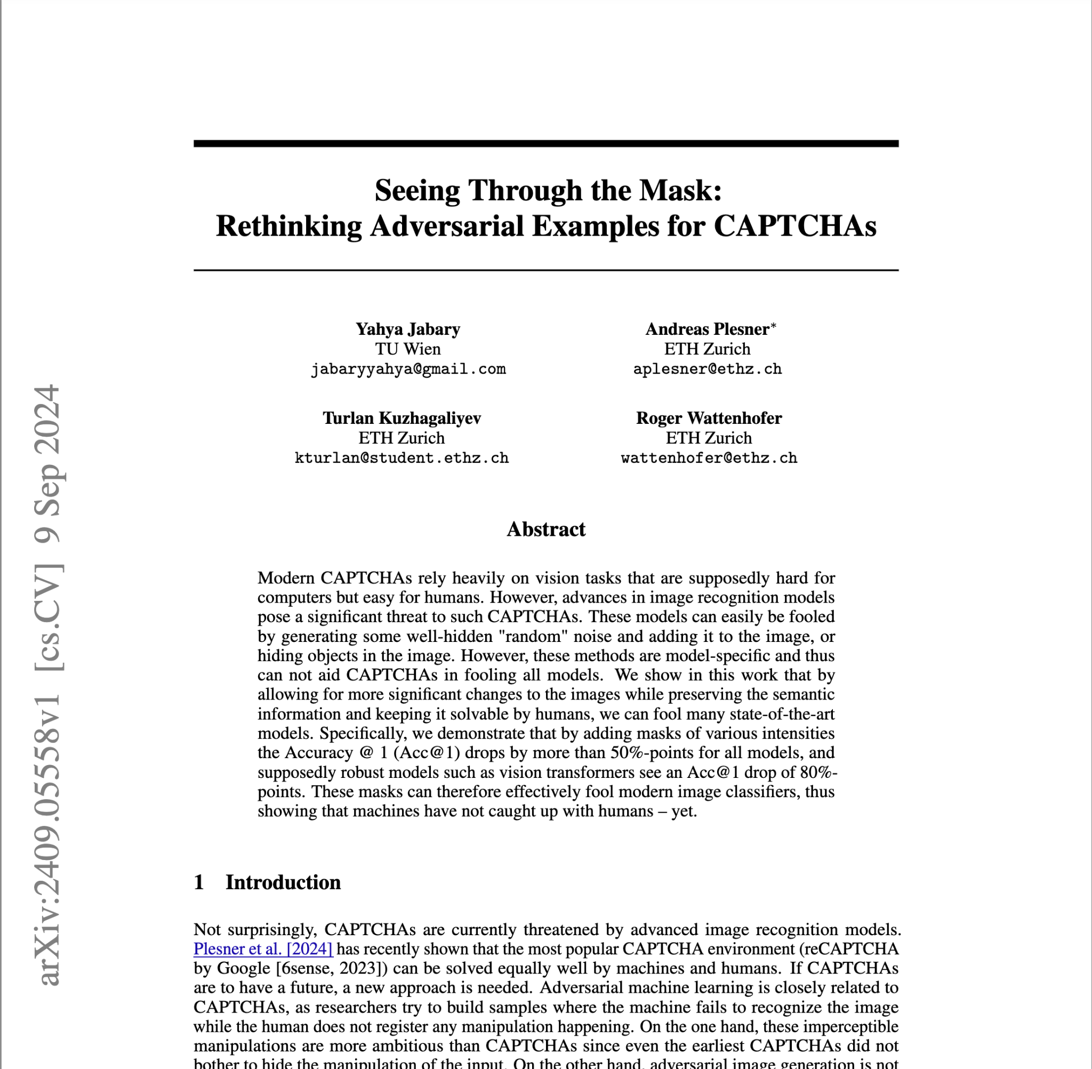
steps:
0. literature review
1. getting inspired by hCaptcha perturbations
2. selecting the best performing models
3. designing experiments
4. benchmarking
5. submitting results as workshop paper

Slide 23
what’s next?
i’d appreciate your advice!

Slide 24
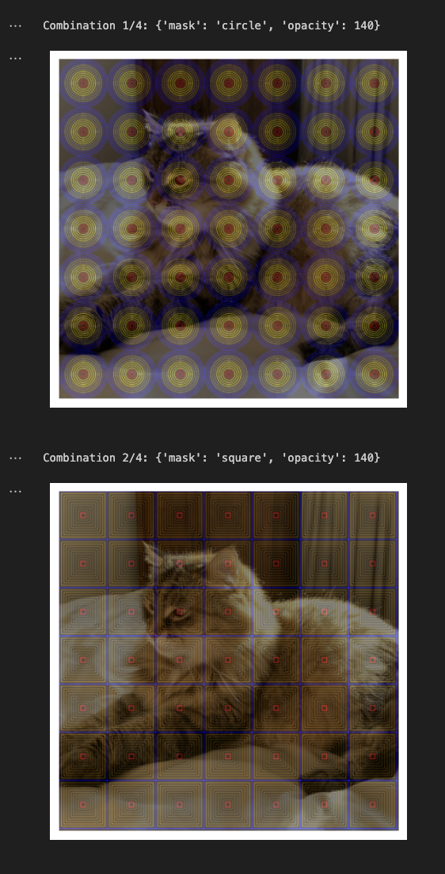
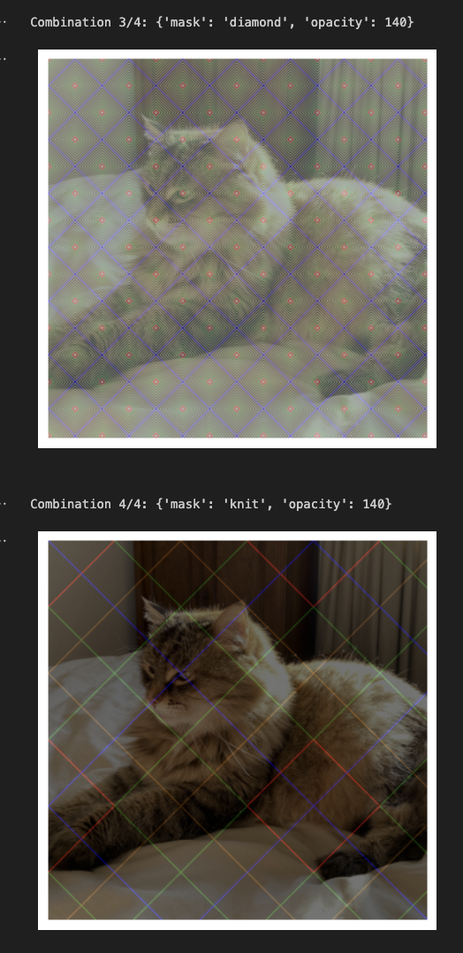
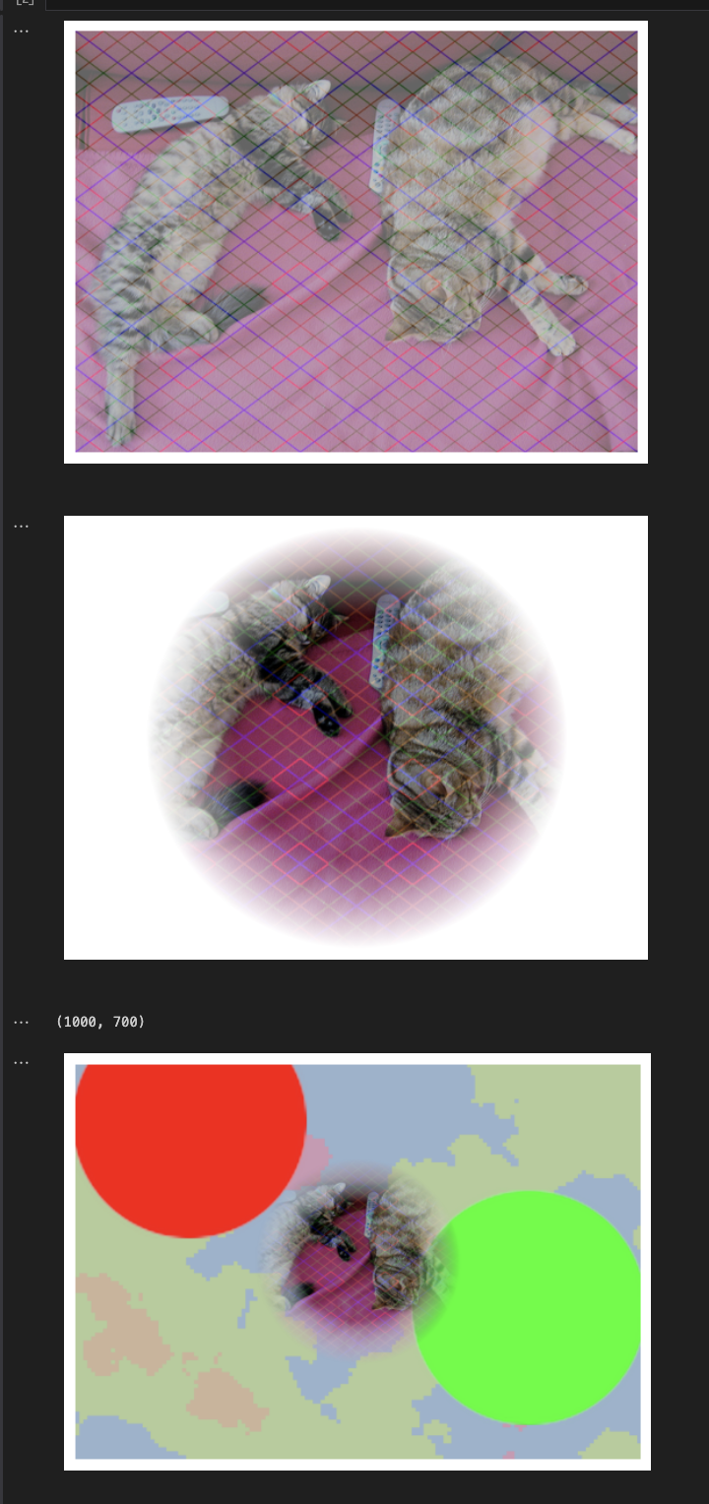
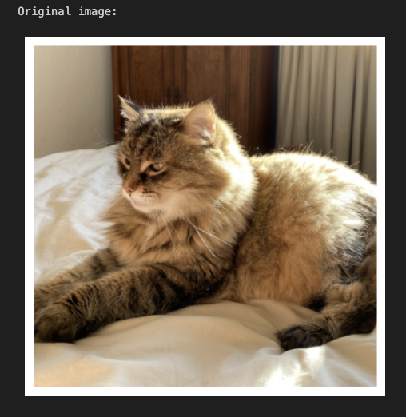
studying geometric distortions of hCaptcha masks
- why were they introduced by this company?
- what makes them so effective?
can we look into intermediary layers to understand?

Slide 25
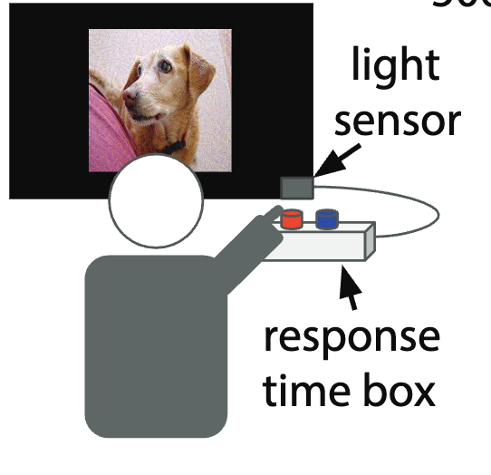
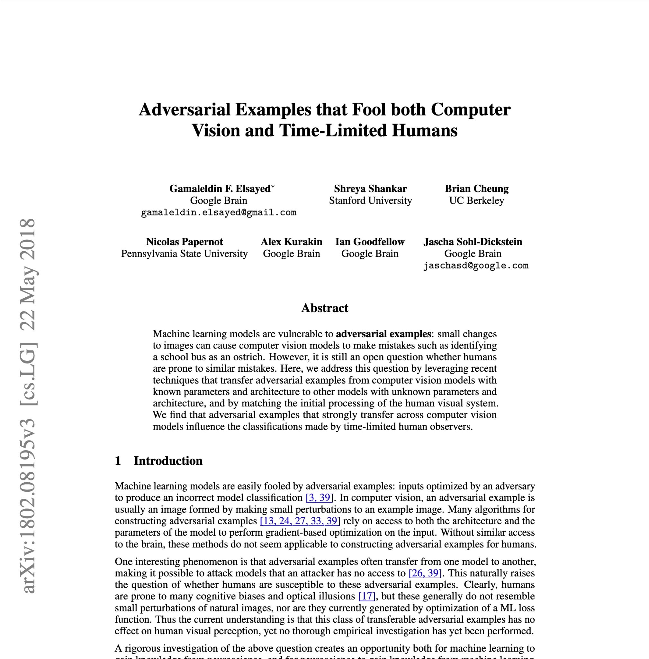
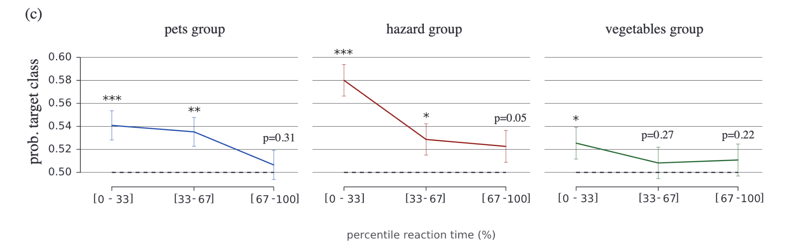
studying survival-optimized features of human vision

Slide 26
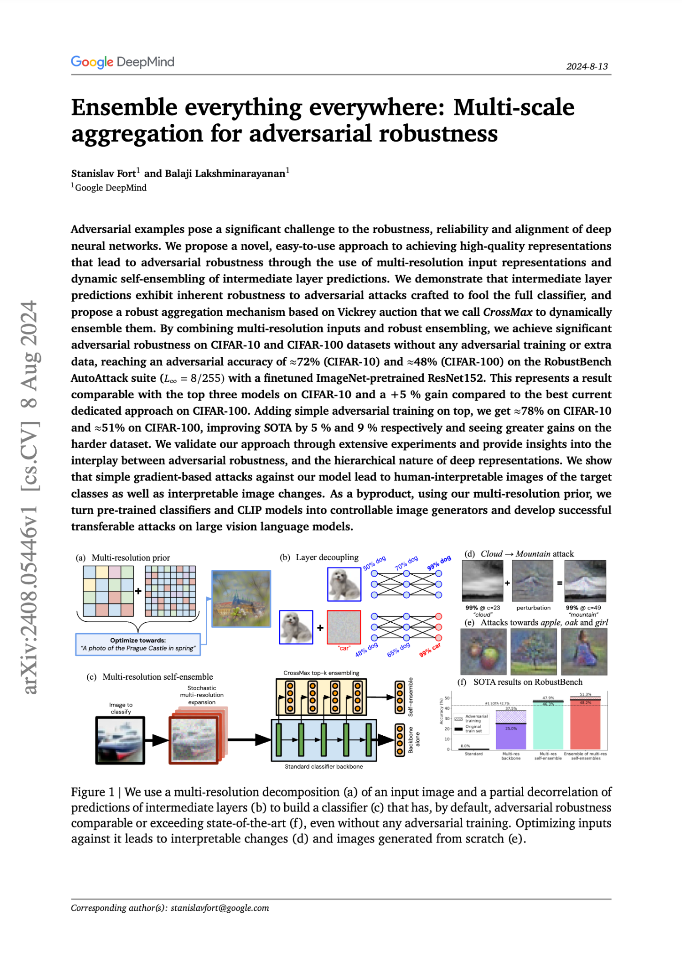
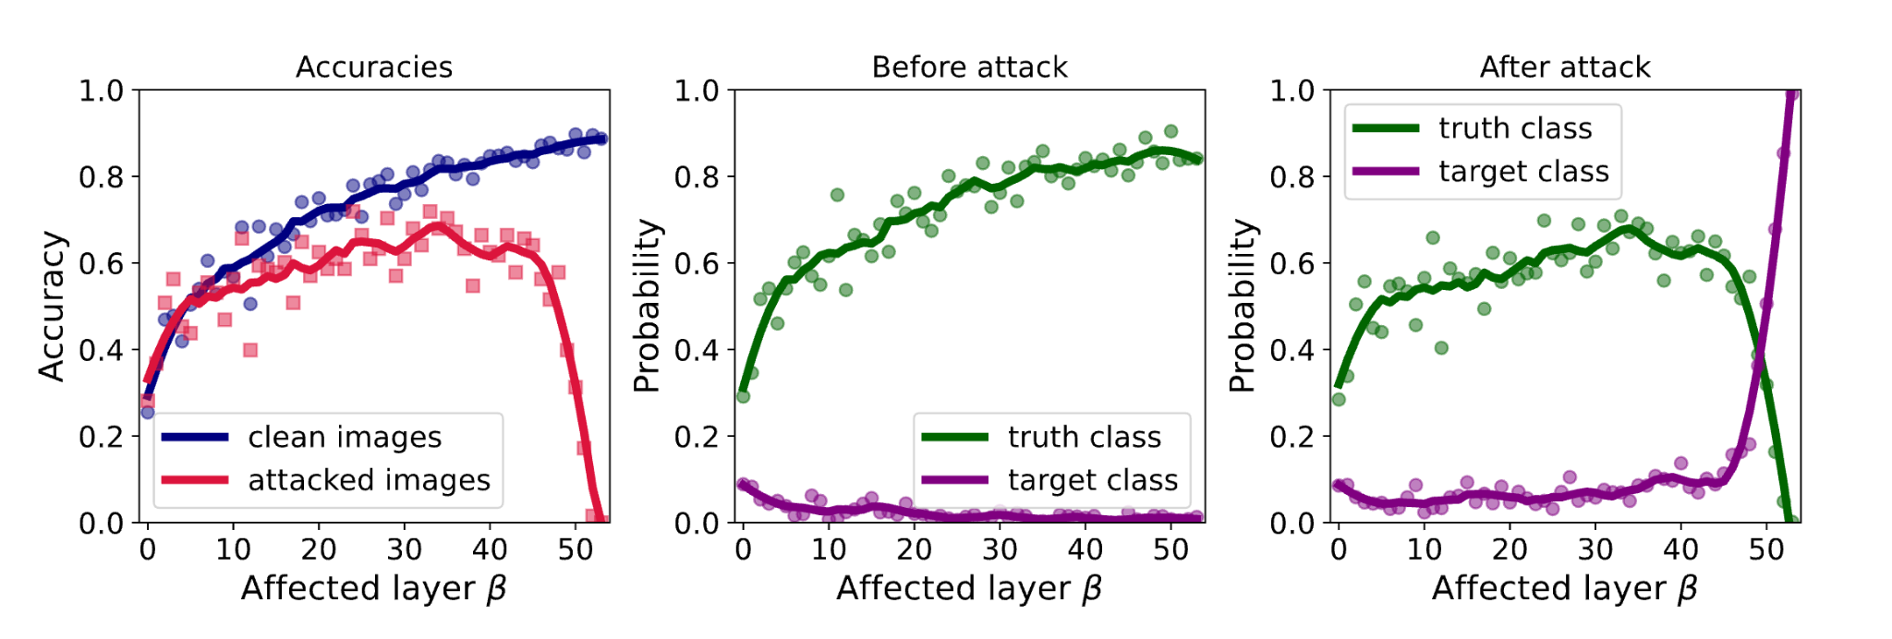
self-ensembling

Slide 27
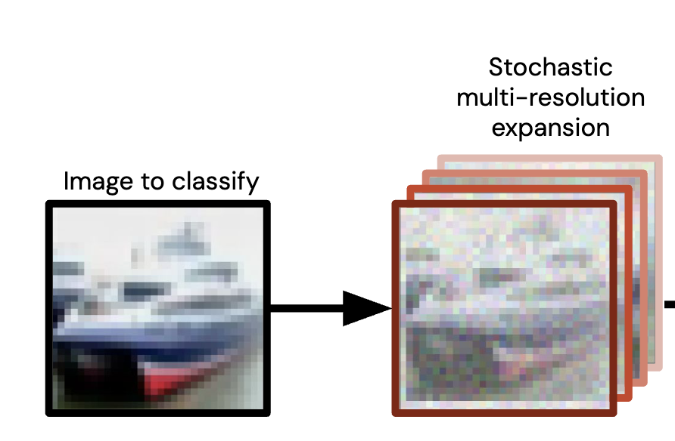
down sampling
classifier makes a decision about all N versions at once
mimicking nature:
1) random noise
2) a random jitter in both axes (microsaccades)
3) a small random change in contrast (cone cells)
4) a small random color-grayscale shift (cone cells)

Slide 28
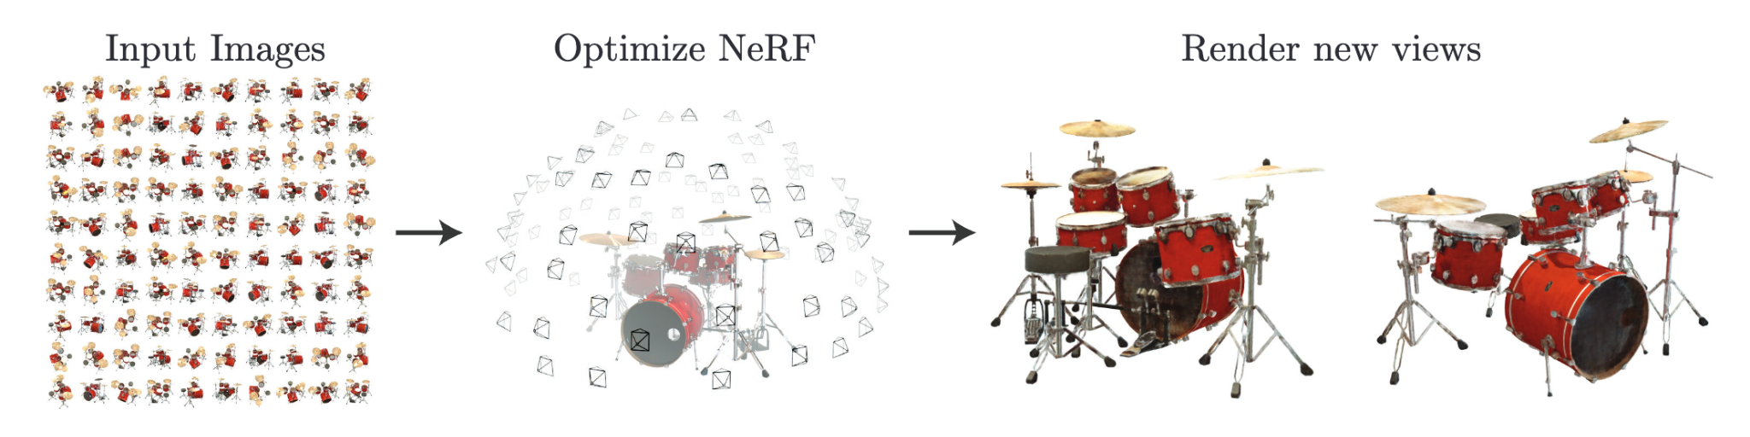
down sampling
classifier makes a decision about all N versions at once
mimicking nature:
1) random noise
2) a random jitter in both axes (microsaccades)
3) a small random change in contrast (cone cells)
4) a small random color-grayscale shift (cone cells)
my idea: combining with NeRFs (Neural Radiance Fields)
https://www.matthewtancik.com/nerf
capturing all angles, distances, under various blurs, rotations, illuminations, contrasts while semantic content is preserved.

Slide 29
thank you for listening!

Slide 30

thank you for listening!
Q&A / discussion
https://xkcd.com/1838/
fun fact: image convolutions can also be expressed algebraically.

